Slide 1
Internet Egress close to the Applications
Aviatrix DCF for Secure Egress

Slide 2













Problem Statement
Private workloads need internet access
SaaS integration
Patching
Updates
NAT Gateway
Squid Proxy
Layer-7 Firewall
NACLs are necessary
Unrestricted access
Hard to manage
Scale and HA issues
Overkill
Expensive
VPC
VPC
VPC
Internet gateway
Internet gateway
Internet gateway
Public subnet
Public subnet
Public subnet
NAT gateway
Firewall
Squid Proxy
Private subnet
Private subnet
Private subnet
Workloads
Workloads
Workloads
Notes:
The private workloads need to access internet for several reasons: for SaaS integration, for patching, for software updates, for version control systems.
On AWS the cloud native that is offered by the CSP is of course the NAT gateway.
This solution only allows the traffic that is generated from the private subnets, thus, if you want to control what nodes can be reach from the workloads inside the private subnets, you can configure the NACL accordingly. However, with a NACL you can only filter based on the IPs and not on the domain names.
The alternate solution to control the traffic going out to Internet from a private subnet is to deploy a SQUID proxy, but this is a black-box and is difficult to manage. Another solution is to deploy a NGFW, but might be too much expensive and can be cumbersome

Slide 3




Aviatrix Secure Egress Filtering
Internet
VPC
VPC
VNet

Slide 4


Aviatrix Secure Egress Filtering
Aviatrix
Controller
Simply Launched
From Any Cloud
Marketplace
Internet
Centralized
Management
Aviatrix
Gateway
Aviatrix
Gateway
Aviatrix
Gateway
VPC
VPC
VNet
Distributed
Control
Distributed
Control
Distributed
Control

Slide 5
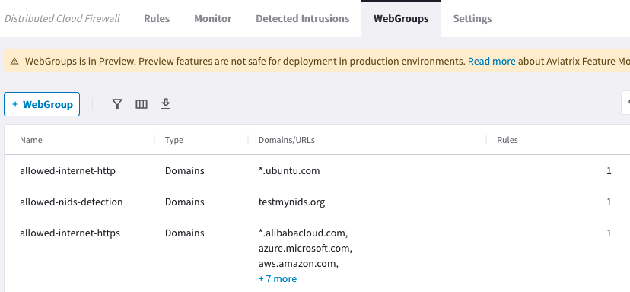
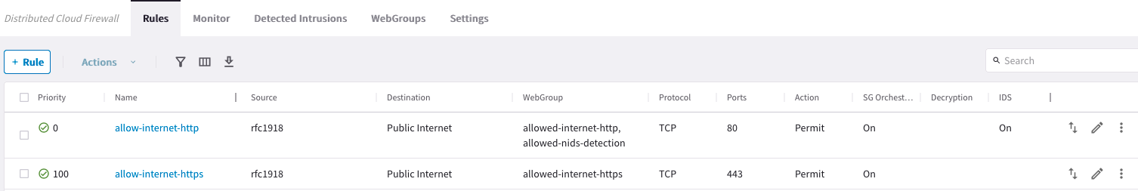

Slide 6
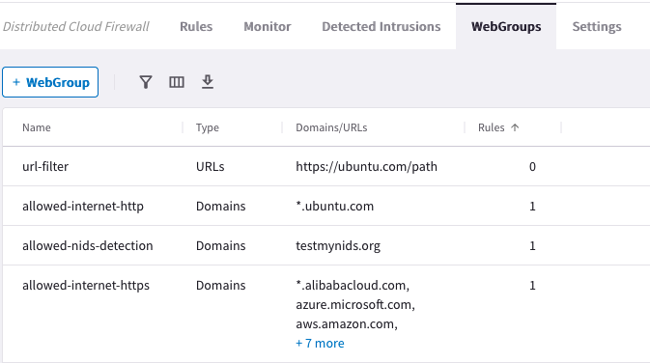

Aviatrix Secure Egress Filtering
Aviatrix
Controller
Internet
Centralized
Management
Egress Filtering
Policies
FQDN/URL Filter
FQDN/URL Filter
FQDN/URL Filter
*.github.com
updates.ubuntu.com
api.twillio.com
deny all
*.github.com
updates.ubuntu.com
api.saas.com
deny all
*.github.com
updates.ubuntu.com
api.google.com
deny all
Aviatrix
Gateway
Aviatrix
Gateway
Aviatrix
Gateway
VPC
VPC
VNet
Distributed
Control
Distributed
Control
Distributed
Control

Slide 7
Aviatrix Secure Egress Filtering
Aviatrix
Controller
Internet
Centralized
Management
Egress Filtering
Policies
FQDN/URL Filter
FQDN/URL Filter
FQDN/URL Filter
*.github.com
updates.ubuntu.com
api.twillio.com
deny all
*.github.com
updates.ubuntu.com
api.saas.com
deny all
*.github.com
updates.ubuntu.com
api.google.com
deny all
Aviatrix
Gateway
Aviatrix
Gateway
Aviatrix
Gateway
VPC
VPC
VNet
Distributed
Control
Filtered
Distributed
Control
Filtered
Distributed
Control
Filtered

Slide 8


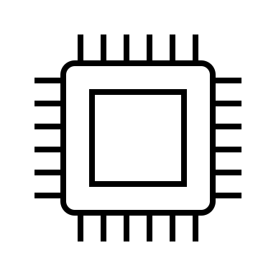






Aviatrix
Controller
Aviatrix
CoPilot
Internet
Internet
Internet
AZ1
AZ2
AZ1
AZ2
AZ1
AZ2
AZ1
AZ2
Aviatrix
Secure Egress
Gateways
Aviatrix
Secure Egress
Gateways
Aviatrix
Secure Egress
Gateways
Aviatrix
Secure Egress
Gateways
Cloud
Workloads
Cloud
Workloads
Cloud
Workloads
Cloud
Workloads
App 1
App 2
App 3
App 4

Slide 9
Aviatrix
Controller
Aviatrix
CoPilot
Internet
Internet
Internet
AZ1
AZ2
AZ1
AZ2
AZ1
AZ2
AZ1
AZ2
Aviatrix
Secure Egress/Spoke
Gateways
Aviatrix
Secure Egress/Spoke
Gateways
Aviatrix
Secure Egress/Spoke
Gateways
Aviatrix
Secure Egress/Spoke
Gateways
Cloud
Workloads
Cloud
Workloads
Cloud
Workloads
Cloud
Workloads
App 1
App 2
App 3
App 4
Notes:
Visualization attaching an application to the Aviatrix Zero Trust Transit and adding East-West controls and micro-segmentation.

Slide 10



Aviatrix Secure Egress Filtering Design Pattern
Local Egress FQDN Filtering (Distributed)
Local Egress FQDN Filtering (Distributed)
with Aviatrix Transit
Centralized Egress
with Aviatrix Transit
Egress FQDN Gateway
Egress FQDN Gateway
VPC
VPC
VPC
VPC
VPC
VPC
Spoke Gateways
Spoke Gateways
Spoke Gateways
Spoke Gateways
Transit VPC
Transit VPC
Transit Gateways
Egress FQDN
Gateway
Notes:
What is the use case for the model on the left? This is for a not full blown solution, when you wanna go with Standalone gateways
Starting point for many enterprises. Solves a very specific pain point of inability of NAT GW to filter on FQDNs.
To replace NAT GWs
Second Model in the middle: Distributed with mcna, hub-spoke topology
Third Model on the right: Centralized with mcna, hub-spoke topology
Internet traffic (egress) should not mix up with the transit traffic
Outage/Maintenance of Spoke GW will not impact Egress traffic or vice versa

Slide 11
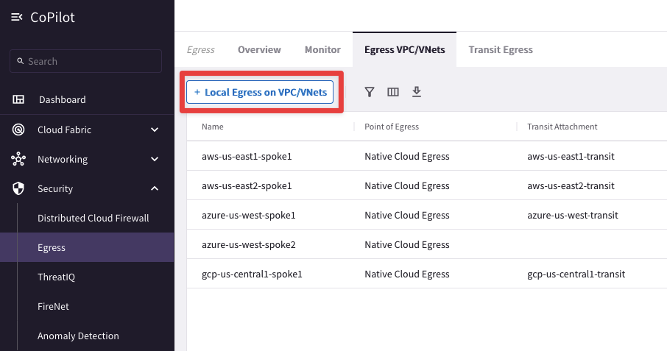
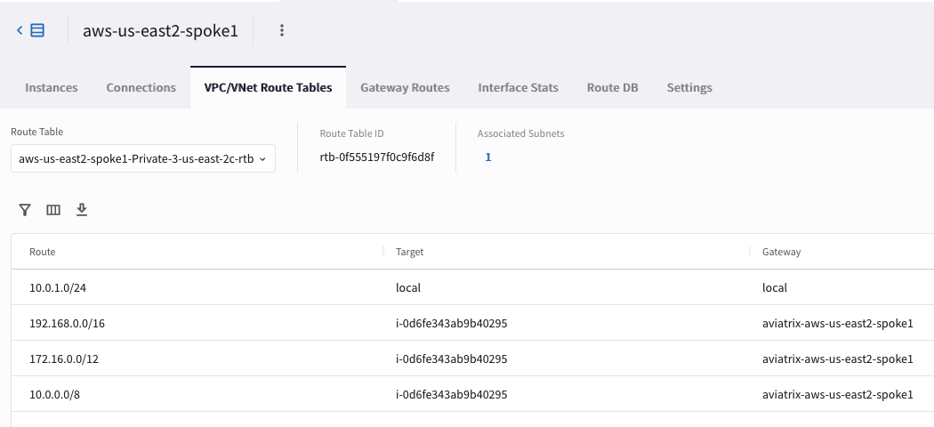
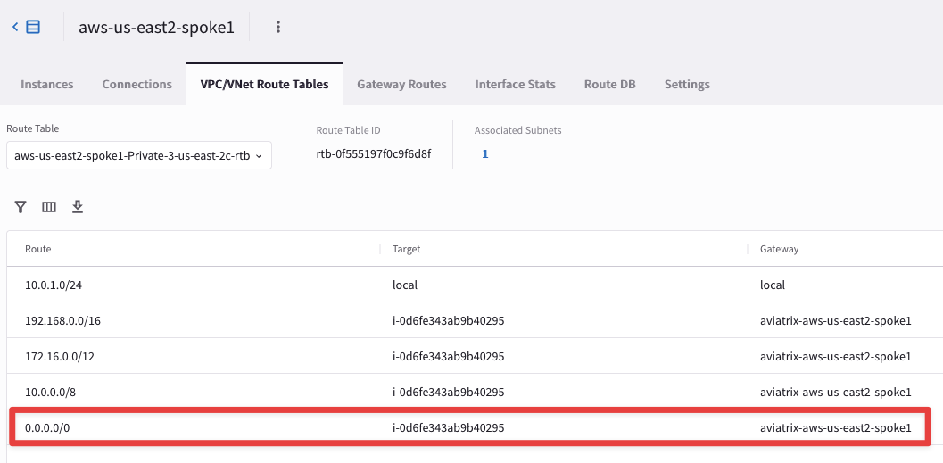
Enable Egress
Adding Egress Control on VPC/VNet changes the default route on VPC/VNet to point to the Spoke Gateway and enables SNAT.
Egress Control also requires additional resources on the Spoke Gateway.
In addition to the Local route, the three RFC1918 routes, also a default route will be injected.
Notes:
Use Case: Operators inherit an environment where they don’t know what site applications visit
Highly popular feature because it is non-invasive / low-risk
This feature allows for easy insertion of Aviatrix Gateways into cloud network
How it works:
Select an AGW to discover what sites the apps visit and select Start
It returns a list of sites in the VPC/Vnet/VCN that the GW visits.
Great for if you don’t know what sites are being allowed in the first place
You can export the list for analyzing offline and then re-import.
AWS Network Firewall DOES NOT support Discovery

Slide 12


Aviatrix Certified Engineer (ACE)
COMMUNITY
https://aviatrix.com/ACE
https://community.aviatrix.com

Slide 13
Aviatrix Advance NAT

Slide 14




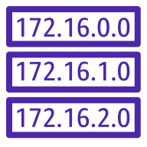


AWS Cloud
Patches
Updates
Code repos
SaaS
Anywhere
Internet
Anywhere
Standalone VPC with NAT Gateway
Standalone VPC with Aviatrix
IGW
IGW
NAT
NAT
FQDN Filtering
Threat Protection
Aviatrix
CoPilot
Geo-Blocking
Visibility
NAT Gateway
NAT Gateway
Aviatrix Gateway
Aviatrix Gateway
0.0.0.0/0 → IGW
0.0.0.0/0 → IGW
Public Subnets
Public Subnets
Aviatrix
Controller
EC2 Instances
EC2 Instances
0.0.0.0/0 → NAT GW
0.0.0.0/0 → Aviatrix
Private Subnets
Private Subnets
AZ1
AZ2
AZ1
AZ2

Slide 15
AWS Cloud
Patches
Updates
Code repos
SaaS
Anywhere
Internet
NAT Gateway data processing charges
Anywhere
VPC using AWS NAT Gateway
VPC using Aviatrix Secure Egress
IGW
IGW
$
NAT
NAT
FQDN Filtering
Threat Protection
Aviatrix
CoPilot
Geo-Blocking
Visibility
NAT Gateway
NAT Gateway
Aviatrix Gateway
Aviatrix Gateway
0.0.0.0/0 → IGW
0.0.0.0/0 → IGW
Public Subnets
Public Subnets
Aviatrix
Controller
EC2 Instances
EC2 Instances
0.0.0.0/0 → NAT GW
0.0.0.0/0 → Aviatrix
Private Subnets
Private Subnets
AZ1
AZ2
AZ1
AZ2

Slide 16
Brown Field Scenario
AWS Cloud
Patches
Updates
Code repos
SaaS
Anywhere
Internet
VPC for Aviatrix Platform
VPC Egress Testing
IGW
IGW
NAT Gateway
NAT Gateway
Aviatrix
CoPilot
0.0.0.0/0 → IGW
Public Subnets
Test EC2 Instance A
Test EC2 Instance B
Aviatrix
Controller
0.0.0.0/0 → NAT GW
Public Subnets
Private Subnets
AZ1
AZ2

Slide 17
Deploy Aviatrix Gateways – no disruption
AWS Cloud
Patches
Updates
Code repos
SaaS
Anywhere
Internet
VPC for Aviatrix Platform
VPC Egress Testing
IGW
IGW
NAT Gateway
Aviatrix Gateway
NAT Gateway
Aviatrix Gateway
Aviatrix
CoPilot
0.0.0.0/0 → IGW
Public Subnets
Test EC2 Instance A
Test EC2 Instance B
Aviatrix
Controller
0.0.0.0/0 → NAT GW
Public Subnets
Private Subnets
AZ1
AZ2

Slide 18
Update the Default Route Table towards Aviatrix NAT GW
AWS Cloud
Patches
Updates
Code repos
SaaS
Anywhere
Internet
VPC for Aviatrix Platform
VPC Egress Testing
IGW
IGW
NAT Gateway
Aviatrix Gateway
NAT Gateway
Aviatrix Gateway
Aviatrix
CoPilot
0.0.0.0/0 → IGW
Public Subnets
Test EC2 Instance A
Test EC2 Instance B
Aviatrix
Controller
Update
0.0.0.0/0 → Aviatrix
Public Subnets
Private Subnets
AZ1
AZ2

Slide 19



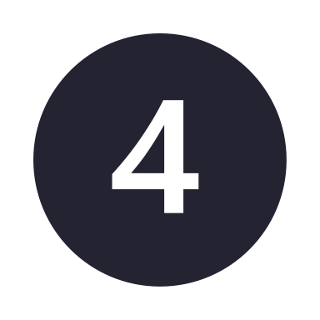



Reduce Cloud Costs, Improve Security, Non-Disruptive Deployment
Reduce Costs
Increase Security
Increase Security
Reduce Costs
$
$
NAT
Egress
NGFW
Replace CSP NAT Gateways
Reduce Cost Immediately
Add Distributed Cloud Firewall
for Egress
Add Full Distributed Cloud Firewall
with Secure Transit for E/W
Take a Bite Out of Firewall Costs
with Distributed Cloud Firewall
Aviatrix Secure NAT Gateway
Non-Disruptive Insertion
Advanced NAT Features
Distributed Cloud Firewall Capable
Visibility and Alerting
Distributed Cloud Firewall for Egress
Advanced Threat Detection
Suricata IDS/IPS
ID Known Malicious IPs
Automated Threat Blocking
Anomaly Detection
Distributed Cloud Firewall for Private Networks
East – West Firewalling
Multicloud Networking
Full Visibility
Micro Segmentation
Deep Packet Inspection
Vulnerability Scanning
Advanced Threat Intelligence
Reduce Number of Existing Firewalls Required for E/W
Reduces License Costs
Reduces Operational Costs
Reduces CSP Data Transfer Costs
Reduces Business Risk

Slide 20
AWS Cloud
Patches
Updates
Code repos
SaaS
Anywhere
Internet
VPC for Aviatrix Platform
VPC Egress Testing
IGW
IGW
NAT Gateway
Aviatrix Gateway
NAT Gateway
Aviatrix Gateway
Aviatrix
CoPilot
0.0.0.0/0 → IGW
Public Subnets
Test EC2 Instance A
Test EC2 Instance B
Aviatrix
Controller
Finish
0.0.0.0/0 → Aviatrix
Start
0.0.0.0/0 → NAT GW
Public Subnets
Private Subnets
AZ1
AZ2

Slide 21
AWS Cloud
Patches
Updates
Code repos
SaaS
Anywhere
Internet
VPC for Aviatrix Platform
VPC Egress Testing
IGW
IGW
NAT Gateway
Aviatrix Gateway
NAT Gateway
Aviatrix Gateway
Aviatrix
CoPilot
0.0.0.0/0 → IGW
Public Subnets
Test EC2 Instance A
Test EC2 Instance B
Aviatrix
Controller
Update
0.0.0.0/0 → Aviatrix
Public Subnets
Private Subnets
AZ1
AZ2

Slide 22
AWS Cloud
Patches
Updates
Code repos
SaaS
Anywhere
Internet
VPC for Aviatrix Platform
VPC Egress Testing
IGW
IGW
NAT Gateway
NAT Gateway
Aviatrix
CoPilot
0.0.0.0/0 → IGW
Public Subnets
Test EC2 Instance A
Test EC2 Instance B
Aviatrix
Controller
0.0.0.0/0 → NAT GW
Public Subnets
Private Subnets
AZ1
AZ2

Slide 23
AWS Cloud
Patches
Updates
Code repos
SaaS
Anywhere
Internet
VPC for Aviatrix Platform
VPC Egress Testing
IGW
IGW
NAT Gateway
Aviatrix Gateway
NAT Gateway
Aviatrix Gateway
Aviatrix
CoPilot
0.0.0.0/0 → IGW
Public Subnets
Test EC2 Instance A
Test EC2 Instance B
Aviatrix
Controller
0.0.0.0/0 → NAT GW
Public Subnets
Private Subnets
AZ1
AZ2

Slide 24

BLOCK Country1, Country 2
AWS Cloud
Patches
Updates
Code repos
SaaS
Anywhere
Internet
Anywhere
Standalone VPC with NAT Gateway
Standalone VPC with Aviatrix
IGW
IGW
NAT
NAT
FQDN Filtering
Threat Protection
Geo-Blocking
Visibility
EC2 Instances
EC2 Instances
NAT gateway
NAT gateway
Aviatrix Gateway
Aviatrix Gateway
Aviatrix
Controller
Cloud
Workloads
0.0.0.0/0 → IGW
0.0.0.0/0 → IGW
Public Subnets
Public Subnets
Aviatrix
CoPilot
Aviatrix
Secure Egress
Gateways
Route table
EC2 Instances
EC2 Instances
App 3
0.0.0.0/0 → NAT GW
0.0.0.0/0 → Aviatrix
App 2
Private Subnets
Private Subnets
AZ1
AZ2
AZ1
AZ2
App 1
ALLOW *.github.com, updates.ubuntu.com
EXCEPT gist.github.com
deny all

Slide 25




Centralized Management
Aviatrix
Controller
Policy Orchestration
Aviatrix
CoPilot
Configuration and Visibility
Internet
FQDN Filtering
ALLOW *.github.com, updates.ubuntu.com
EXCEPT gist.github.com
deny all
Threat Prevention
Geo-Blocking
BLOCK Russia, North Korea
VPC
VPC
VPC
Distributed Perimeter Control

Slide 26
Aviatrix
Controller
Aviatrix
CoPilot
Internet
Internet
Aviatrix
Secure Egress
Gateways
Aviatrix Transit
Gateways
Aviatrix
Secure Egress
Gateways
AZ1
AZ2
AZ1
AZ2
Cloud
Workloads
Cloud
Workloads
App 1
App 2
Notes:
Visualization attaching an application to the Aviatrix Zero Trust Transit and adding East-West controls and micro-segmentation.

Slide 27
Reduce Cloud Costs, Improve Security, Non-Disruptive Deployment
Reduce Costs
Increase Security
Increase Security
Reduce Costs
$
$
NAT
Egress
NGFW
Replace CSP NAT Gateways
Reduce Cost Immediately
Add Distributed Cloud Firewall
for Egress
Add Full Distributed Cloud Firewall
with Secure Transit for E/W
Take a Bite Out of Firewall Costs
with Distributed Cloud Firewall
Aviatrix Secure NAT Gateway
Non-Disruptive Insertion
Advanced NAT Features
Distributed Cloud Firewall Capable
Visibility and Alerting
Distributed Cloud Firewall for Egress
Advanced Threat Detection
Suricata IDS/IPS
ID Known Malicious IPs
Automated Threat Blocking
Anomaly Detection
Distributed Cloud Firewall for Private Networks
East – West Firewalling
Multicloud Networking
Full Visibility
Micro Segmentation
Deep Packet Inspection
Vulnerability Scanning
Advanced Threat Intelligence
Reduce Number of Existing Firewalls Required for E/W
Reduces License Costs
Reduces Operational Costs
Reduces CSP Data Transfer Costs
Reduces Business Risk

Slide 28








AWS Cloud
AWS Step Functions
AWS Lambda
AWS CloudFormation
AWS Identity and Access Management (IAM)
Lambda function
Template
IAM Roles
VPC for Aviatrix Platform
VPC for Egress Testing
IGW
IGW
NAT Gateway
Aviatrix Gateway
Aviatrix
Controller
Aviatrix
CoPilot
Elastic IP address
Elastic IP address
Test EC2 Instance

Slide 29
BLOCK Country1, Country 2
AWS Cloud
Patches
Updates
Code repos
SaaS
Anywhere
Internet
Anywhere
Standalone VPC with NAT Gateway
Standalone VPC with Aviatrix
IGW
IGW
NAT
NAT
FQDN Filtering
Threat Protection
Geo-Blocking
Visibility
EC2 Instances
EC2 Instances
NAT gateway
NAT gateway
Aviatrix Gateway
Aviatrix Gateway
Aviatrix
Controller
Cloud
Workloads
0.0.0.0/0 → IGW
0.0.0.0/0 → IGW
Public Subnets
Public Subnets
Aviatrix
CoPilot
Aviatrix
Secure Egress
Gateways
Route table
EC2 Instances
EC2 Instances
App 3
0.0.0.0/0 → NAT GW
0.0.0.0/0 → Aviatrix
App 2
Private Subnets
Private Subnets
AZ1
AZ2
AZ1
AZ2
App 1
ALLOW *.github.com, updates.ubuntu.com
EXCEPT gist.github.com
deny all

